Slide 1
MACHINE LEARNING
TOPIC : Climate prediction through regression models

Slide 2
Objective
Purpose of this project is to predict the temperature using different algorithms like linear regression and Decision tree regression. The output value should be numerically based on multiple extra factors like maximum temperature, minimum temperature, cloud cover, humidity, and sun hours in a day, precipitation, pressure and wind speed.

Slide 3
Methodology
We are using regression models for prediction purpose
1. Linear regression
2. Decision tree regression

Slide 4
Linear regression model v/s decision tree model
Linear regression is a parametric method. The line of best fit is determined by minimizing the sum of the squared distances between the predicted values and the actual values. Linear regression assumes that the relationship between the independent variables and the dependent variable is linear.
Decision tree is a non-parametric method. The tree is built by recursively splitting the data into smaller subsets based on the values of the independent variables, with the goal of minimizing the variance of the dependent variable within each subset. Decision tree regression can handle non-linear relationships between the independent variables and the dependent variable, and can also handle categorical variables.

Slide 5
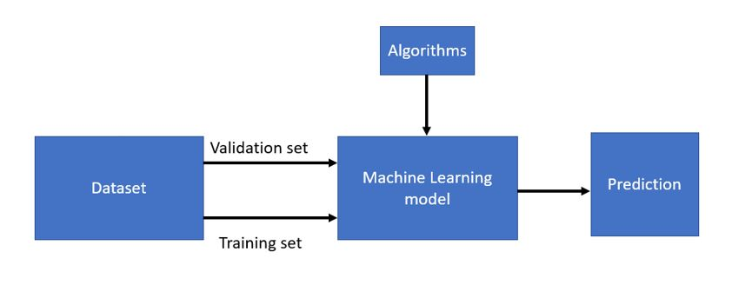
Block Diagram

Slide 6
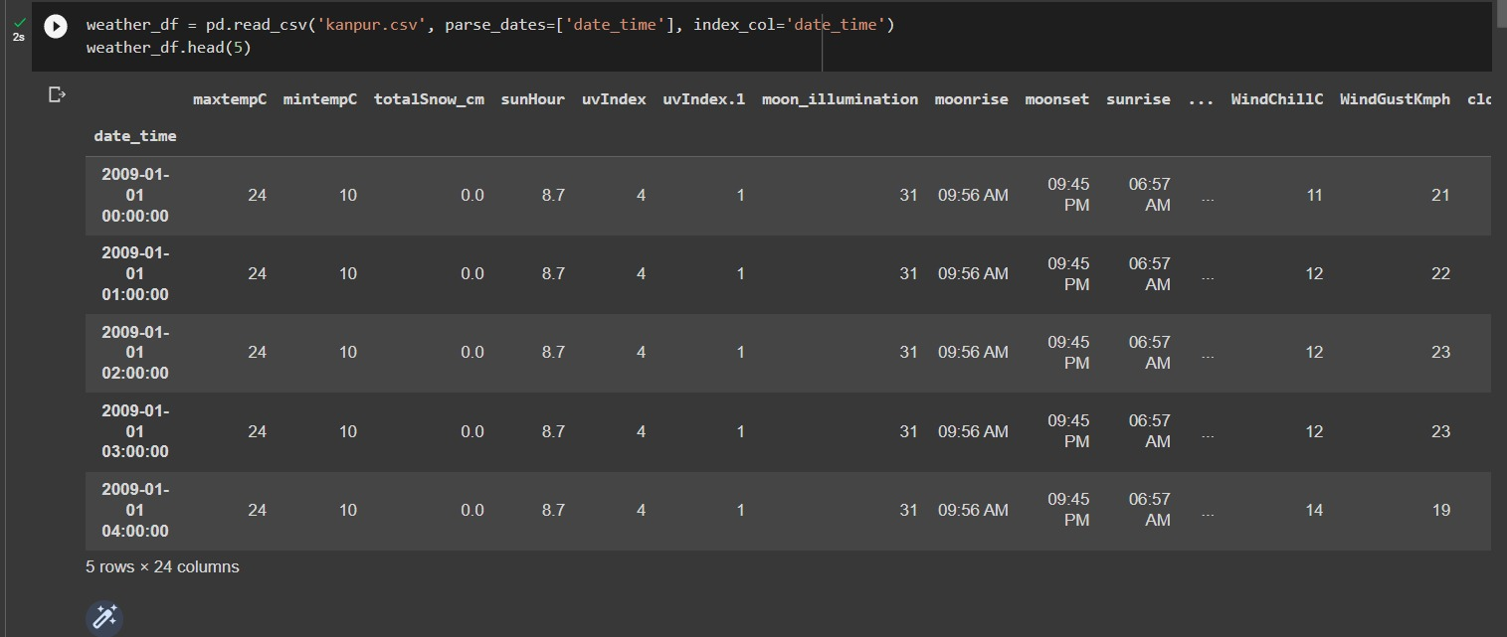
Steps
Loading the dataset

Slide 7
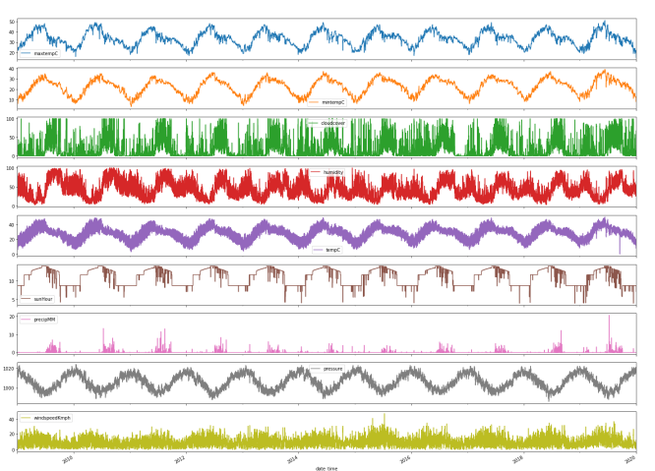
Steps
2. Checking for null values and other normalisation proceedures
3. Plots for maxtemp,mintemp,cloudcover,humidity,tempc,sunhour,heatindex,precipitation, pressure,windspeed.

Slide 8
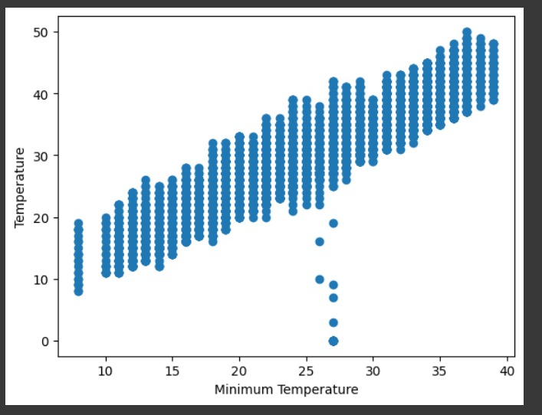
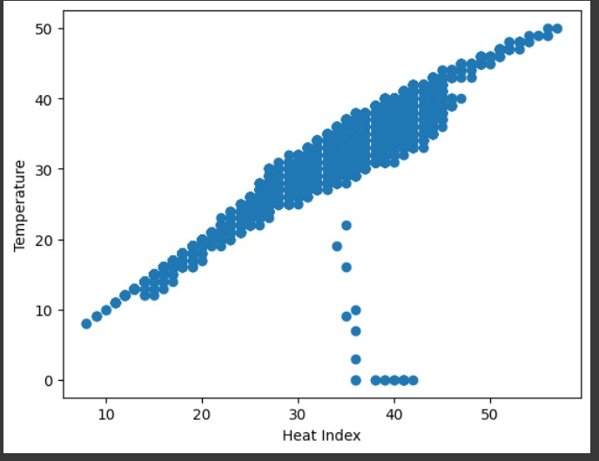
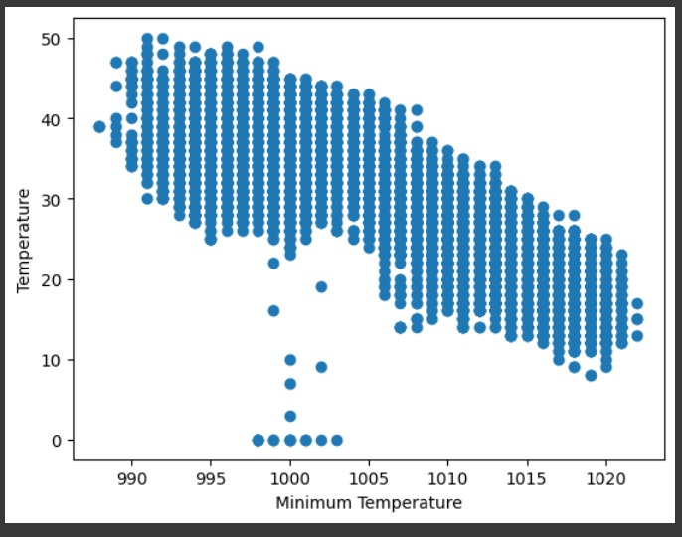
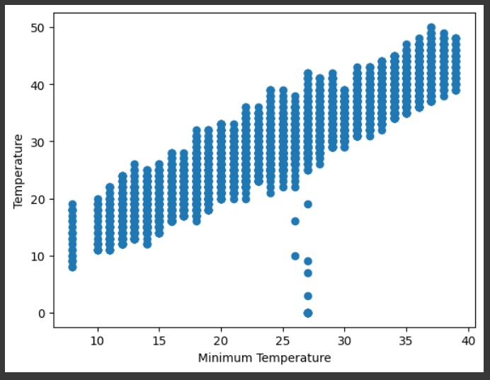
Steps
5. Scatter plots

Slide 9
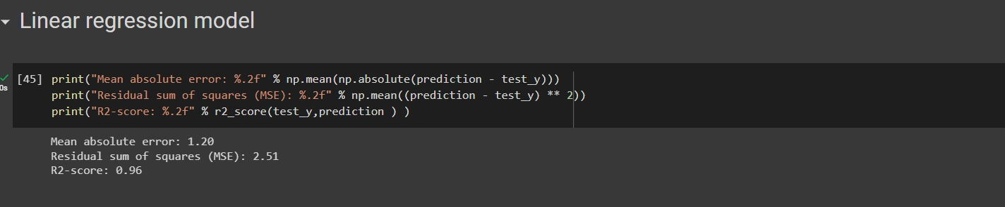
Steps
6. Results in linear regression model

Slide 10
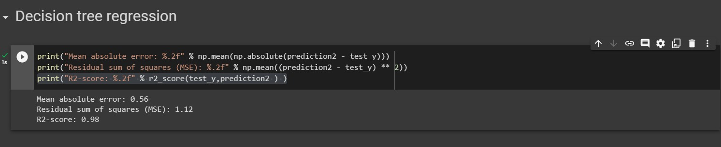
Steps
7. Results in decision tree

Slide 11
Comparision
We have used linear regression model and decision tree and our objective is to find which model is better.
Decision tree model is giving better results, the mean square error is less when compared to the linear regression model.
Why is decision tree model more efficient than linear regression model? 1. It can handle non-linear relationships 2. Flexible model 3. It can handle missing data ,outiliers and other data quality issues

Slide 12
Result
Successfully predicted temperature in a regression model and used both linear regression and decision tree model.
Decision tree model is efficient.

Slide 13
References
https://www.kaggle.com/datasets/hiteshsoneji/historical-weather-data-for-indian-cities
https://towardsdatascience.com/weather-forecasting-with-machine-learning-using-python-55e90c346647

